Slide 1
Remembering lists of values lists
Susan Ibach | Technical Evangelist
Christopher Harrison | Content Developer

Slide 2
Sometimes you have to remember lists of values
I want to remember the names of everyone coming to a party
I want to remember the scores I got in all my courses
I want to remember the directions to get to my doctor appointment

Slide 3
Lists allow you to store multiple values
guests = ['Christopher','Susan','Bill','Satya']
scores = [78,85,62,49,98]

Slide 4
You can create an empty list and add values later
guests = []
scores = []

Slide 5
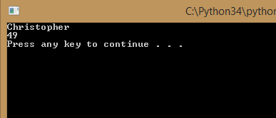
You can reference any value in the list by specifying it’s position in the list
guests = ['Christopher','Susan','Bill','Satya']
#print the first guest
#the first value is in position 0
print(guests[0])
scores = [78,85,62,49,98]
#Print the fourth score
print(scores[3])

Slide 6
Geek Tip
We call the position of an item in the list the index

Slide 7
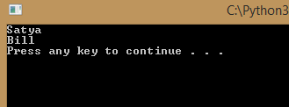
You can even count backwards
guests = ['Christopher','Susan','Bill','Satya']
#print the last entry in the list
print(guests[-1])
#print the second last entry in the list
print(guests[-2])

Slide 8
Creating and populating a list

Slide 9
What if you want to change the list contents?

Slide 10
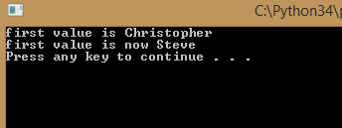
You can change a value in a list
guests = ['Christopher','Susan','Bill','Satya']
print("first value is " + guests[0])
#change the first value in the list to Steve
guests[0] = 'Steve'
print("first value is now " + guests[0])

Slide 11
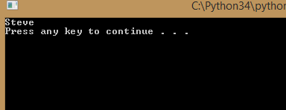
You can add a value to a list with append()
guests = ['Christopher','Susan','Bill','Satya']
#add a new value to the end of the list
guests.append('Steve')
#display the last value in the list
print(guests[-1])

Slide 12
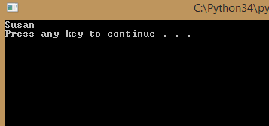
You can remove a value from a list with remove()
guests = ['Christopher','Susan','Bill','Satya']
#add a new value to the end of the list
guests.remove('Christopher')
#display the last value in the list
print(guests[0])

Slide 13
You can use the del command to delete an entry
guests = ['Christopher','Susan','Bill','Satya']
#delete the first item in the list
del guests[0]
#print the first item in the list
print(guests[0])

Slide 14
Modifying list contents

Slide 15
What if I want to check if a particular value is in the list?

Slide 16
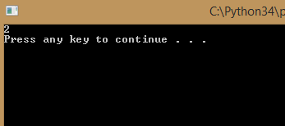
The index() function will search the list and return the index of the position where the value was found
guests = ['Christopher','Susan','Bill','Satya']
#this will return the index in the list
#where the name Bill is found
print(guests.index('Bill'))

Slide 17
Searching a list

Slide 18
What do you think will happen if we search for a value that doesn’t exist in the list?
guests = ['Christopher','Susan','Bill','Satya']
#this will return the index in the list
#where the name Steve is found
print(guests.index('Steve'))
The code crashes!
We need to add error handling
Or find another way to go through the list and find a value

Slide 19
What if I want to see all the values in the list?

Slide 20
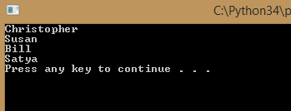
Use a loop!
guests = ['Christopher','Susan','Bill','Satya']
#Create a loop that executes four times
#Since we have four values
for steps in range(4) :
#Remember the value of steps goes up by one
#Each time the loop executes
print(guests[steps])

Slide 21
Looping through all the values in a list

Slide 22
What if I don’t know how many values are in the list?

Slide 23
Use the len() function to find out how many entries are in your list
guests = ['Christopher','Susan','Bill','Satya']
#Find out how many entries are in the list
nbrEntries = len(guests)
#Create a loop that executes once for each entry
for steps in range(nbrEntries) :
print(guests[steps])

Slide 24
Shhhh, don’t tell anyone but there is an even easier way to go through all the items in a list

Slide 25
You can just tell the for loop to go through your list!
guests = ['Christopher','Susan','Bill','Satya']
#specify the name of your list and a variable name
#to hold each entry as you go through the loop
for guest in guests :
#the variable guest will contain the values
#as we go through the loop
print(guest)

Slide 26
Want to sort your list?

Slide 27
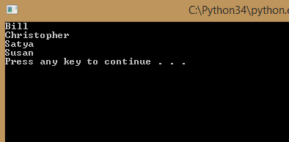
You can sort your list with the sort() function
guests = ['Christopher','Susan','Bill','Satya']
#Sort the names in alphabetical order
guests.sort()
#print the list
for guest in guests :
print(guest)

Slide 28
Sort a list and print the results

Slide 29
Your challenge… Starting to get harder…
Ask the user to enter the names of everyone attending a party
Then return a list of the party guests in alphabetical order
This will require pulling together everything we have learned so far, so let’s walk through the thought process of idea to code

Slide 30
Break the problem into steps
Ask the users to enter the names of everyone attending a party
Put those values in a list
Sort the list
Print the sorted list

Slide 31
1. Ask the user to enter the names of everyone attending a party
What command do we use to ask a user for a value?
input function
What type of variable will we need to store all the names?
A list
How can I ask the user for more than one name?
Use a loop

Slide 32
Should we use a for loop or while loop?
Do you know how many names the user will enter?
No, that means we don’t know how many times the loop needs to execute, so we should use a while loop
How will the loop know when to stop executing?
We could have user enter a special keyword when they are done (as long as we tell them to do it!)

Slide 33
2. Put those values in a list
Declare an empty list
Each time a new name is entered, add it to the list

Slide 34
3. Sort the list
Once the values are in a list, use the sort function to sort the list alphabetically

Slide 35
4. Print the sorted list
Use a loop to go through the values in the list
For each value, print the name

Slide 36
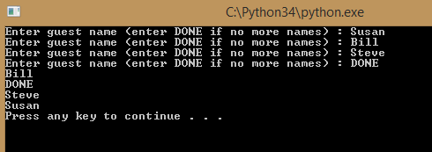
So… something like this?
guests = []
name = " "
while name != "DONE" :
name = input("Enter guest name (enter DONE if no more names) : ")
guests.append(name)
guests.sort()
for guest in guests :
print(guest)
We are close but our code added the name DONE to our list of guests
How can we tell the program that if the name is “DONE” not to add it?

Slide 37
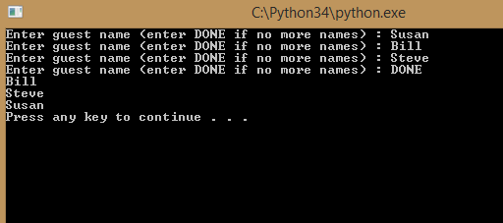
Use an if statement. You are gradually building a toolkit to solve different problems!
guests = []
name = " "
while name !="DONE" :
name = input("Enter guest name (enter DONE if no more names) : ")
if name.upper() != "DONE" :
guests.append(name)
guests.sort()
for guest in guests :
print(guest)

Slide 38
Congratulations!
You can now remember a list of different values
You can search the list for a specific value
You can sort the list
You can read through all the values in the list

